Slide 1

IoT Based Smart Environmental Monitoring System
Name of the Student and reg no:
K. Niharika (192411124)
R.Indhu(192524332)
CSA5158 Python programming for Scientific computing
Course Faculty : Dr. P Vijayaraghavan
Dr. S K Aruna
Professor, SIMATS Engineering, SIMATS

Slide 2
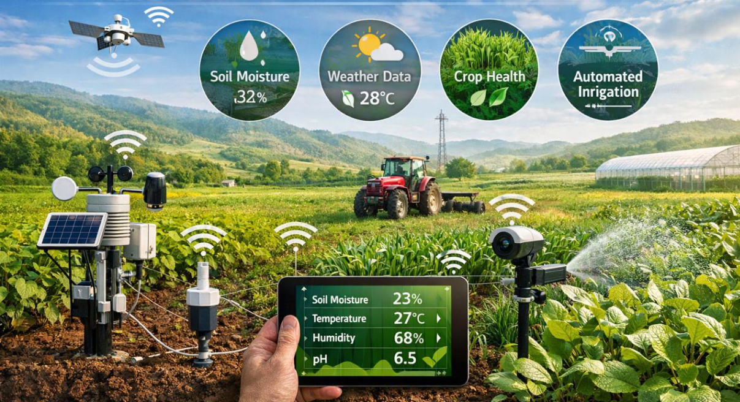
INTRODUCTION
Environmental monitoring is essential for public safety, agriculture, and pollution control.
Traditional monitoring methods are manual and do not provide real-time information.
IoT technology enables automatic collection and transmission of environmental data.
The proposed system uses ESP8266 NodeMCU with temperature, humidity, soil moisture, rain, and gas sensors.
Sensor data is displayed on an LCD and monitored remotely through Wi-Fi.
Telegram alerts are generated when environmental parameters exceed predefined limits.

Slide 3
PROBLEM STATEMENT
Environmental conditions such as temperature, humidity, gas levels, rainfall, and soil moisture can change rapidly and affect safety and productivity.
Traditional monitoring methods rely on manual observation and lack real-time tracking.
Delayed detection of hazardous conditions may lead to environmental damage and safety risks.
There is a need for a system that can continuously monitor environmental parameters and provide instant alerts.
An IoT-based solution can enable real-time monitoring, remote access, and timely decision-making.

Slide 4
OBJECTIVES
To monitor environmental parameters such as temperature, humidity, soil moisture, rainfall, and gas levels in real time.
To collect and process sensor data using the ESP8266 NodeMCU.
To provide remote monitoring through Wi-Fi and a web dashboard.
To generate instant Telegram alerts when abnormal conditions are detected.
To improve environmental safety through continuous monitoring.
To develop a low-cost and efficient IoT-based monitoring system.

Slide 5
LITERATURE SURVEY
S.NO | Author | Year | Paper Title | Contribution
1 | Popsecu et al. | 2024 | AI and IoT Driven Technologies for Environmental Pollution Monitoring | Used AI and IoT for smart pollution monitoring.
2 | Adeagbo | 2024 | IoT Based Environment Monitoring System Using ESP32 | Real-time monitoring using ESP32 and cloud platform.
3 | Mamalis & Gerakidis | 2024 | Environmental Monitoring Framework using WSN and Edge Computing | Improved scalability and data processing efficiency.
4 | Low-Cost IoT Air Quality Monitoring Research | 2024 | IoT Air Quality Monitoring with Cloud Platform | Enhanced air quality monitoring using cloud services.
5 | Rao et al. | 2025 | IoT-Enabled Environmental Monitoring Systems | Discussed future trends, challenges, and AI integration.

Slide 6
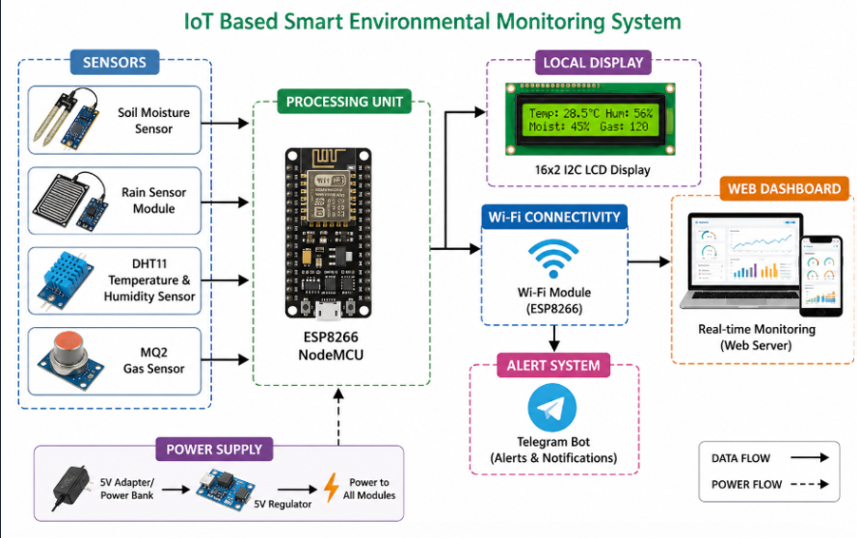
SYSTEM ARCHITECTURE

Slide 7
MODULE 1: DATA ACQUISITION MODULE
Description:
This module collects environmental data from various sensors and sends it to the ESP8266 for processing.
Components:
ESP8266 NodeMCU
Soil Moisture Sensor
Rain Sensor Module
DHT11 Sensor
MQ2 Gas Sensor
Functions:
Measure soil moisture level
Detect rainfall
Monitor temperature
Monitor humidity
Detect gas leakage and smoke

Slide 8
IMPLEMENTATION
Working Process:
Sensors continuously collect environmental data.
Soil Moisture Sensor measures soil water content.
Rain Sensor detects rainfall conditions.
DHT11 measures temperature and humidity.
MQ2 detects smoke and harmful gases.
ESP8266 reads and processes sensor values.
Data is forwarded to the monitoring module.
Output:
Real-time environmental data collection.
Accurate sensor readings for further analysis.

Slide 9
MODULE-2: MONITORING & ALERT MODULE
Description
This module displays environmental data and generates alerts when abnormal conditions are detected.
Components
ESP8266 NodeMCU
Wi-Fi Module
16×2 I2C LCD Display
Web Dashboard & Telegram Bot
Functions
Display sensor values
Enable remote monitoring
Upload data through Wi-Fi
Generate alert notifications
Store and visualize environmental data

Slide 10
IMPLEMENTATION
Working Process:
ESP8266 receives sensor data.
Values are displayed on LCD and web dashboard.
Sensor readings are compared with threshold limits.
Telegram alerts are sent when abnormal conditions occur.
Alert Conditions:
Soil Moisture < 30% → Soil Dry Alert
Temperature > 30°C → High Temperature Alert
Humidity < 40% → Low Humidity Alert
Rain Detected → Rain Alert
Gas Detected → Gas Leakage Alert
Output:
Real-time monitoring & Remote data access

Slide 11
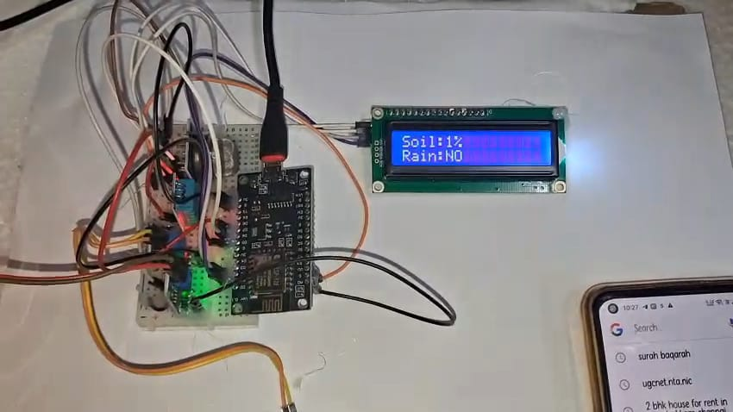
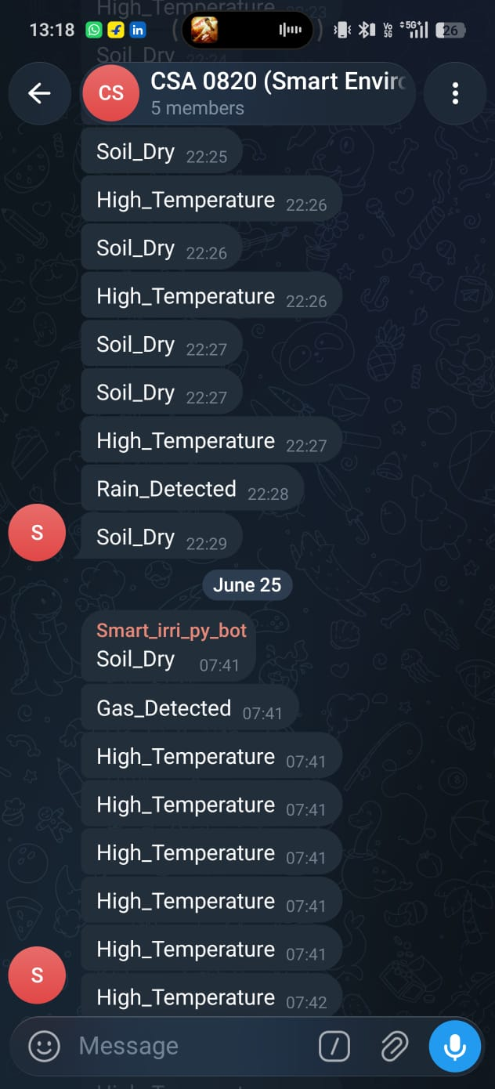
OUTPUT

Slide 12
APPLICATIONS
Smart Agriculture – Monitor soil moisture and weather conditions.
Greenhouse Monitoring – Maintain optimal conditions for plant growth.
Weather Monitoring Stations – Track environmental parameters in real time.
Industrial Safety – Detect gas leaks and hazardous conditions.
Smart Cities – Support environmental and pollution monitoring.
Residential Safety – Monitor home surroundings and receive alerts.
Research & Environmental Studies – Collect and analyze environmental data.

Slide 13
FUTURE SCOPE
Integration of Artificial Intelligence (AI) for environmental prediction.
Development of a mobile application for easier monitoring.
Addition of advanced sensors for air and water quality monitoring.
Implementation of solar-powered sensor nodes for energy efficiency.
Integration with smart city infrastructure.
Automated control systems for responding to critical environmental conditions.

Slide 14
CONCLUSION
The proposed system provides a smart and efficient solution for real-time environmental monitoring.
It continuously monitors temperature, humidity, soil moisture, rainfall, and gas levels using IoT sensors.
Wi-Fi connectivity enables remote monitoring through a web dashboard, while Telegram alerts provide instant notifications.
The system helps in early detection of abnormal environmental conditions and improves safety.
Its low-cost and scalable design makes it suitable for agriculture, smart cities, industrial safety, and environmental management.

Slide 15
REFERENCES
Rahman et al. (2024) – Enhancing IoT-Based Environmental Monitoring and Power Forecasting Using AI Models, Applied Sciences.
Banciu et al. (2024) – Monitoring and Predicting Air Quality with IoT Devices, Processes Journal.
Chen et al. (2024) – Web-Based IoT Environmental and Lighting Monitoring System Using Node-RED and MQTT, Internet of Things Journal.
Kanwal et al. (2025) – Energy-Efficient IoT-Based Wireless Sensor Network for Environmental Monitoring, Computer Systems Science and Engineering.
Madan et al. (2025) – Smart Waste Management and Air Pollution Forecasting Using IoT and Neural Networks, Waste Management & Research.

Slide 16


